Slide 1
RMCuff Team Member(s): David Baez, Marc Roger Product Owner(s): Peter Dickson Instructor: Masoud Sadjadi
School of Computing and Information Sciences Florida International University
Senior Project Final Presentation Fall 2015
December 11, 2015
Notes:
Greet your audience, thank them for attending your presentation, introduce yourself, introduce your project, introduce your team members, and quickly indicate what each of you did in a high-level manner, and put more emphasis on your part/contribution.

Slide 2
Problem definition
Whole Project:
Elderly blood pressure patients face a problem, they lack a way to effectively leverage technology and the help of loved ones (caregivers) to stay on top of their blood pressure monitoring and reporting.
Emerging fitness technology products provide over-functionality, vast UIs, and over-complication.
The old way of tracking results on paper requires a lot of tedious data tracking and communication.
My Part:
RMCuff Patient/Caregiver Communication (Push Notification) API
RMCuff UI
Caregiver Schedule setting system
Blood Pressure text reports for secondary caregivers
Notes:
Introduce the problem that the whole project tackles and stay focused on the parts that you have been working. Indicate if there is an existing previous system, enumerate its problems/limitations, etc.

Slide 3
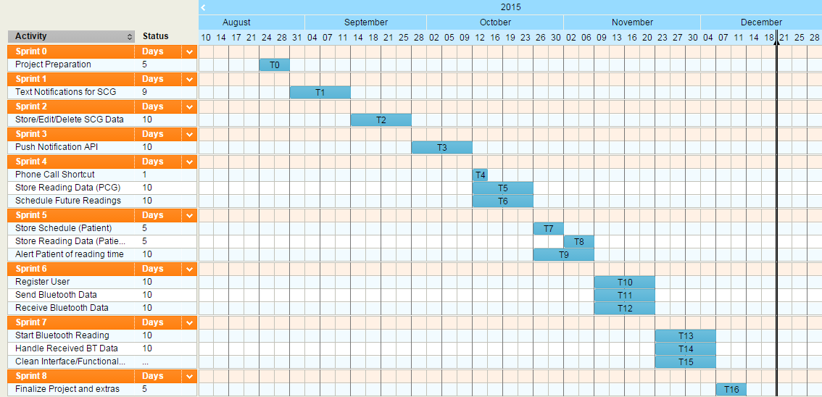
Project Management
Gantt Chart (Minimized to fit)
Notes:
Project Management (schedule for entire semester) (one slide; Gantt Chart).

Slide 4
Requirements: User Stories
User Story # 675 - Push schedule to Patient (Required)
As a Primary Caregiver, I want to be able to alert the patient (via push notification) when I create a new scheduled reading. So that they receive a push notification and take their blood pressure reading on time.
User Story # 676 - Push new reading data to Primary Caregiver (Required)
As a Patient, I want to notify a Primary Caregiver (via push notification) when I take a blood pressure reading. So that they know I’ve taken my reading.
User Story # 666 - Text Notifications to Secondary Caregivers (Required)
User Story # 678 - Alert patient of reading time (Required)
User Story # 697 - Register as a user (Required)
Notes:
4. Requirements:
4.1. User stories implemented (one or more slides).
4.2. UML use cases and the use case diagram for the implemented use cases (one or more slides).
4.3. UML sequence diagrams for the implemented use cases.

Slide 5
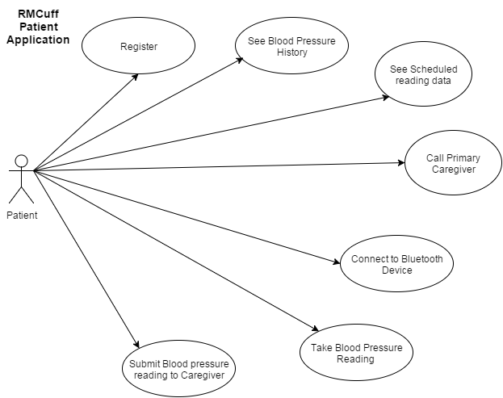
Requirements: Use Cases (Patient)
Notes:
4. Requirements:
4.1. User stories implemented (one or more slides).
4.2. UML use cases and the use case diagram for the implemented use cases (one or more slides).
4.3. UML sequence diagrams for the implemented use cases.

Slide 6
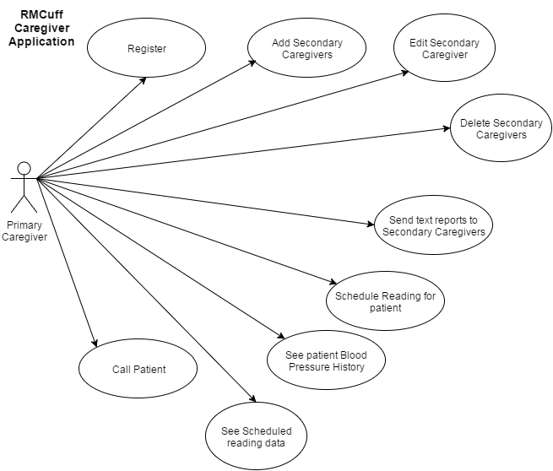
Requirements: Use Cases (Caregiver)
Notes:
4. Requirements:
4.1. User stories implemented (one or more slides).
4.2. UML use cases and the use case diagram for the implemented use cases (one or more slides).
4.3. UML sequence diagrams for the implemented use cases.

Slide 7
System Design: Architecture
Model View Controller (MVC) Architecture - We make use of this pattern to separate user interface code, data access code, and interaction code, making it easier to modify one without affecting the other.
Client/Server Architecture - We implemented a custom php web service hosted on our web server which we communicate with via the app. This web service handles the sending of push notifications. One app sends data up to the server, the server takes that data and sends it to the specified user.
Notes:
5. System design:
5.1. System decomposition; identify the architecture patterns used (one slide).
5.2. System deployment – h/w and s/w requirements (one slide).
5.3. Persistent data design (one slide).
5.4. Security/Privacy (one slide).

Slide 8
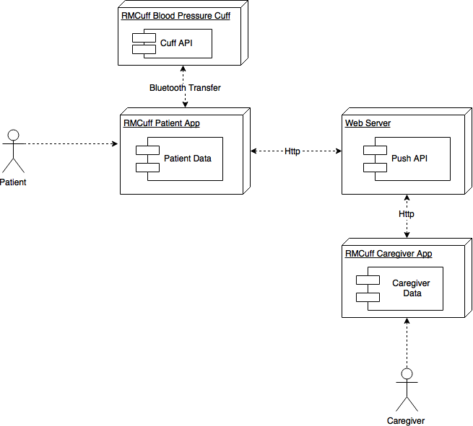
System Design: Deployment
Top
Contribution
UML Deployment
Diagram
Notes:
5. System design:
5.1. System decomposition; identify the architecture patterns used (one slide).
5.2. System deployment – h/w and s/w requirements (one slide).
5.3. Persistent data design (one slide).
5.4. Security/Privacy (one slide).

Slide 9
System Design: H/W & S/W Requirements
The software resources that will be used to develop the system from beginning to end are:
Android Studio - Android’s official integrated development environment (IDE)
Java JDK - Includes tools for developing, debugging, and monitoring Java applications
Android SDK - Includes development tools, an emulator, and required libraries to build Android applications
Java - Programming language used in native Android applications
Arduino IDE - Used for programming the arduino bluetooth device
PushBots - A push notification service used to send implemented to send push notifications between the 2 different apps and have them wake automatically.
GitHub - Online repository that will store our project code
Mingle - Used for planning scrum sprints
The hardware resources that will be used to develop the system from beginning to end are:
Any computer that meets the specifications required by Android Studio
Any Android device to test the application on
A custom bluetooth blood pressure cuff to connect to
Notes:
5. System design:
5.1. System decomposition; identify the architecture patterns used (one slide).
5.2. System deployment – h/w and s/w requirements (one slide).
5.3. Persistent data design (one slide).
5.4. Security/Privacy (one slide).

Slide 10
System Design
Persistent Data Design
All persistent data is stored locally in phone data using a modified model of the Android Shared Preferences in a dictionary Key:Value style.
We were able to grow upon this by serializing entire objects and classes into value objects using a modified JSON called GSON.
Security/Privacy
Security was considered a non issue by the Product Owner for Version 1 of the application.
Most of the development process was focused on prototyping user functionality, however, obvious steps such as serialization locally stored user data were taken for security reasons.
Notes:
5. System design:
5.1. System decomposition; identify the architecture patterns used (one slide).
5.2. System deployment – h/w and s/w requirements (one slide).
5.3. Persistent data design (one slide).
5.4. Security/Privacy (one slide).

Slide 11
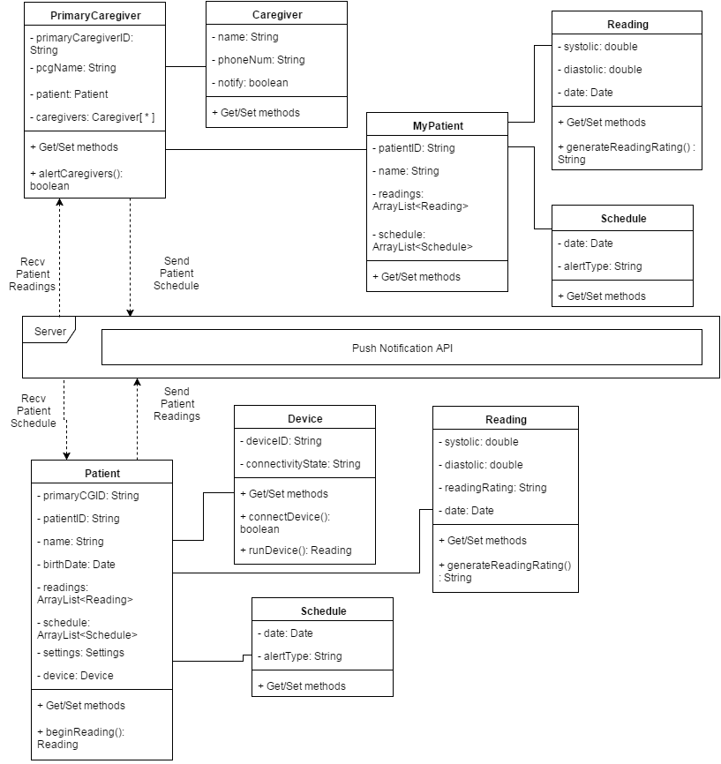
Minimal Class Diagram
Notes:
6. Detailed design:
6.1. Minimal class diagram. Identify the design patterns used (one or more slides).
6.2. State machine for the main control object or the most important object of the implemented uses cases (one or more slides).
6.3. Main algorithm used related to an implemented use case described above (one or more slides).

Slide 12
Test Suites and Test Cases
Automated test scripts
Our automated test scripts involved the usage of an Android Emulator as well as using the JUnit functionality built into android studio.
This allowed us to use testing driven development to make sure that all changes that were made to project passed all previous test cases and that each user story had a test case tied to it.
This way if any new code was to be added and one test did not pass then we would know that the code needed to be changed so that all test cases passed.
Notes:
7. Test Suites and Test Cases (one sunny day and one rainy day) for the use case represented in part (5) above (2 slides).
7.1 One sunny day and one rainy day for the implemented use cases (one or more slides).
7.2 Automated test scripts for the implemented use cases (one or more slides).

Slide 13
Summary
My major contributions to the project include building the:
RMCuff Patient/Caregiver Communication (Push Notification) API
RMCuff UI
Caregiver Schedule setting system
Blood Pressure Text Report system for secondary caregivers
Our software applications continue to make progress, and we have agreed to continue working together with our Product Owner, Peter Dickson, to get the product past Version 1, and ready for production within a year’s time.
Contact Info
David Baez
dbaez011@fiu.edu
(786) 315 - 8886
Notes:
Summarize your contribution
Include your contact information
Ask if anyone has any questions for you.
Thank your audience

